Slide 1
Transforming chips wrappers into sustainable solutions
Presented by Group 4

Slide 2
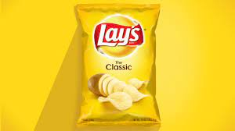
Disadvantages of LAY’S Packets
Lay’s packets are made of multi-layered materials which are not easily recyclable.
They lack the Durability which makes them easily tear or break , making it unsuitable for purposes that require strength and stability.
Improper disposal of lays packets contribute to plastic pollution and can have detrimental effects on environment.

Slide 3
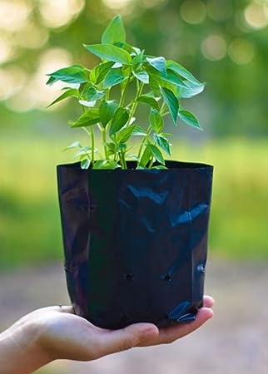
Black PLASTIC COVERS (TEMPORARY FLOWER POT)
Many of us would have seen this cover during campaigns involving sustainable development and plant distribution .
These covers are made of Low density Polythene. Although it is frequently used in many materials, it is not that easily recyclable and poses an environment threat in long term.

Slide 4
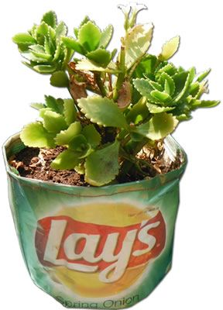
USING LAY’S PACKETS AS SUBSTITUTE FOR BLACK PLASTIC COVERS
We could avoid manufacturing black plastic covers which take so many years to decompose and use lay’s in a effective way.
Using Lay’s packaging to keep a plant as a temporary container might be feasible if the packaging is cleaned and sanitized properly.
It’s always recommended to transfer the plant to a proper flower pot to ensure its health and growth.

Slide 5
WHY LAY’S PACKET?
BY USING IT TO STORE PLANTS, WE CREATE A SUSTAINABLE PRODUCT WHICH REDUCES THE LARGE NUMBER OF CHIPs WRAPPERS THAT ARE DUMPED EVERYDAY.
it can be used by ngo/nurseries which distributes free saplings to communities. it would create awareness of plant growth and at the same time introduce the idea of sustainability to masses.
Because of its durability, it can be used several times without significant harm to plants.

Slide 6
EACH SMALL ACTION THAT WE TAKE CAN CREATE A GREENER , MORE SUSTAINABLE WORLD FOR TOMORROW!

